Slide 1
Visualizing and Understanding Convolutional Networks
김주영

Slide 2
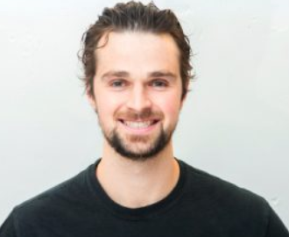
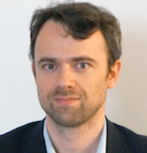
Visualizing and Understanding Convolutional Networks
(2013)
Matthew D. Zeiler
Rob Fergus
Dept. of Computer Science, Courant Institute,
New York University
Ceo of Clarifai
Dept. of Computer Science,
Courant Institute,
New York University

Slide 3
01
introduction
CNNs : excellent performance at image classification
▼
no clear understanding of
1. why they perform so well
2. no idea of how they achieve such good performance
3. how to improve cnn

Slide 4
02
Goal
visualization :
reveal the input stimuli that excite feature maps at any layer in the model
(reconstruction)
Using multi-layered deconvolutional network:
map the feature activities back to the input pixel space
- sensitivity analysis of classifier(Semantic Segmentation)
reveal which parts of the scene are important for classification

Slide 5
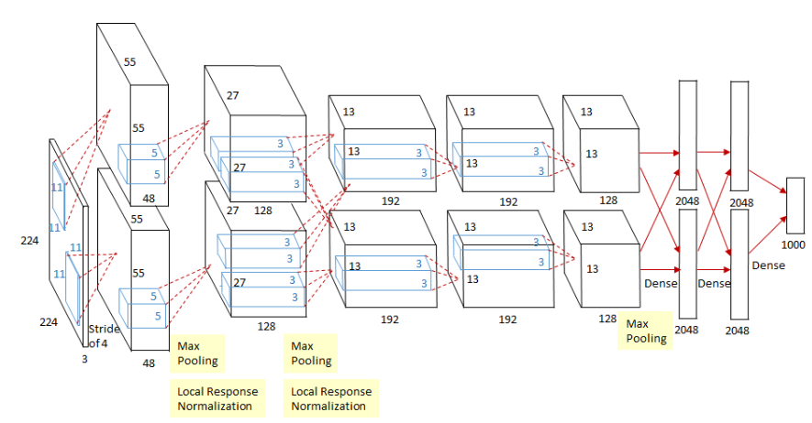
03
Structure of Alexnet
5 conv layer, 3 fc layer - loss function: cross-entropy
Overlapping Max-pooling - softmax
Relu activation function - LRN for layer 1,2(before max pool)
Reducing overfitting: dropout(last two)
2 GPUS

Slide 6
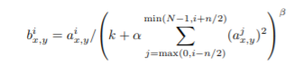
03
Structure of Alexnet- LRN
N(total number of kernel), k=2, n=5(#사용할 근접필터)
beta=0.75,alpha=10^-4
goal: detect high frequency features with a large response (form of local maxima)
lateral inhibition
⇒ enhance “peaks” and dampen “flat” responses on the feature map
With relu activation ( relu’s output = unbounded)
- Why need normalization layers in the first place? Increasing the sensory perception

Slide 7
04
Deconvolution process
CNN
Deconv
Input
conv(▼)
relu
<feature map>
maxpooling(▼)
output
input
unpooling rectification
filtering
Reconstruct image
*set zero (▲)
Zero pad; sparse
(▲;dense)

Slide 8
04
vocabulary
Upsampling: (≒unpooling) sort of cnn filter! image to a higher resolution
Unpooling: reverse max pooling(usually), use switch variables
preserving the structure of the stimulus( make enlarged but yet sparse)
Deconvolution: inverse convolution, densify feature maps with trainable filters
(transposed filter -> fill out sparse feature map) usually after unpooling!
4. Convolutional sparse coding: zero padding at transposed filter

Slide 9
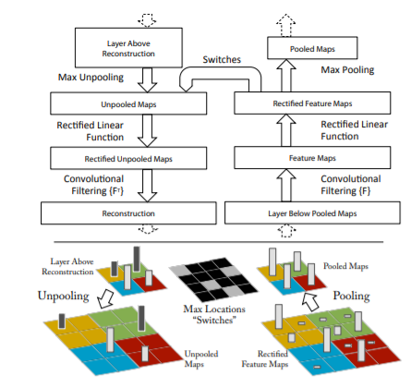
04
Deconvolution process
*set zero? Set all other activations in the layer to zero and pass the feature maps
Unpooling
SWITCH variables: recorded the locations of
the maxima within each pooling region
2. Rectification: relu function
3. filtering: transposed versions of the same filters
(apply to the rectified maps)

Slide 10
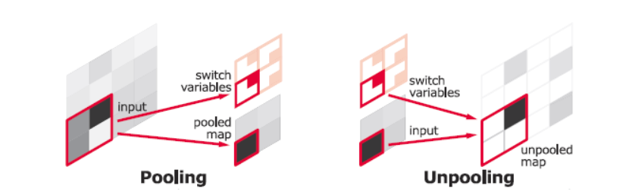
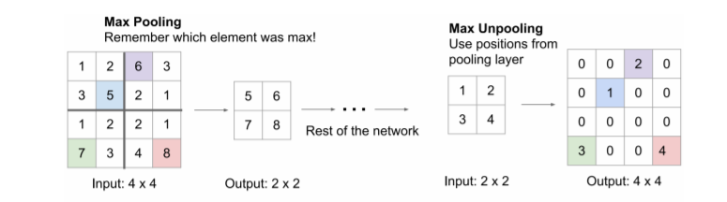
04
Unpooling

Slide 11
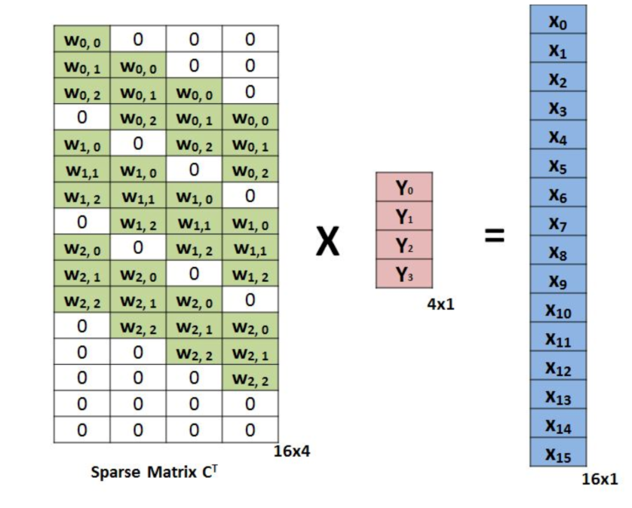
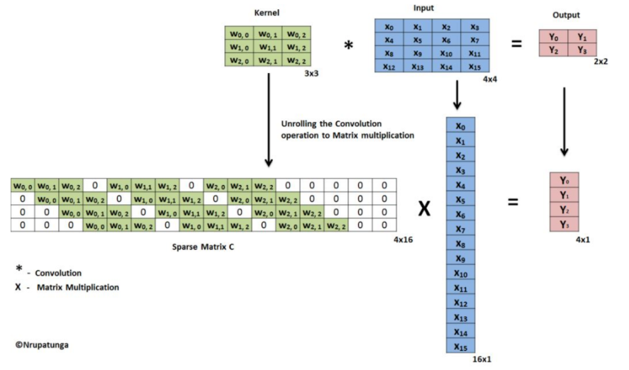
04
Transpose convolutions- filtering
Kernel: original filter( conv filter)
Input: image
Sparse matrix c:
Each row defines one conv operation
Sparse matrix c`: deconv filter
Pink matrix: output of unpooling&relu
Output: reconstruction of input image
(result of deconv layer)

Slide 12
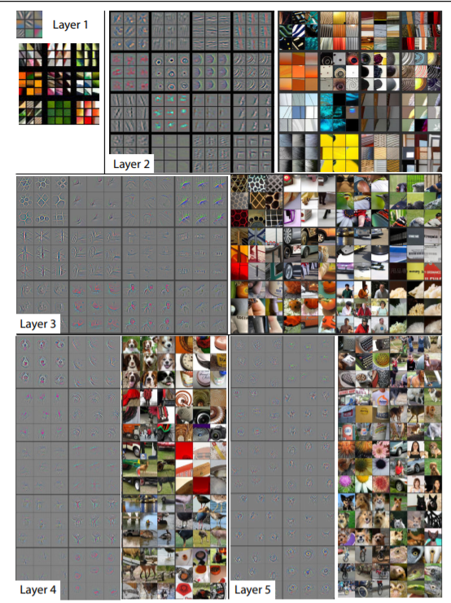
05
Convnet visualization-1:
Top 9 activations for layer 2-5
- The strong grouping within each feature map
- Greater invariance at higher layers
- Exaggeration of discriminative parts of the image
( ex. Layer 4, r=1,c=1)
Result: The projections from each layer show
the hierarchical nature of the features in the network
Layer1,2: corner, edge/color (low-level feature)
Layer3: strong complex invariance, textures
Layer4: more class-specific( ex. Face, leg)
Layer5: entire objects’ position (high-level feature)

Slide 13
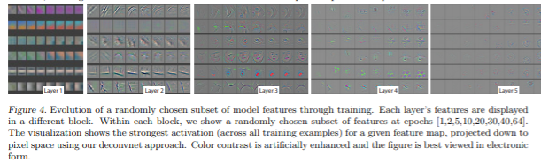
05
Convnet visualization-2:
Feature evolution during training
Visualize the progress while training the strongest activation
Result: lower layers(fewer epochs), higher layers(require 40-50 epochs)
the time to acquire features is different by layers

Slide 14
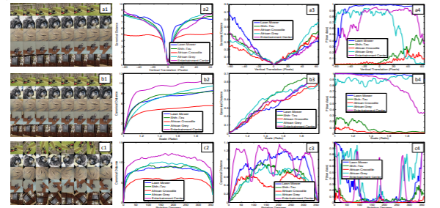
05
Convnet visualization-3
Feature invariance
R1: translate image : stable
R2: scaling image : stable
R3: rotation(not symmetry) image: not invariant
C2,C3: Euclidean distance(layer1,7)
C4: probability of the true label for each image

Slide 15
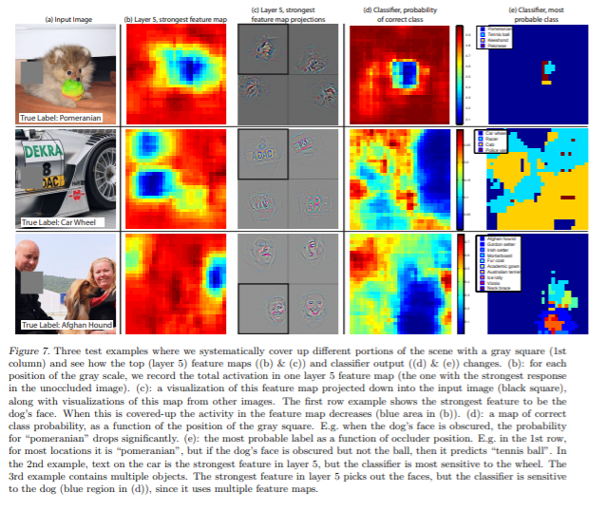
05
Convnet visualization-4
Occlusion sensitivity
Visualized layer 5 => feature face,position
occluding different portions of the input image
- localizing the objects within the scene
- Result:
the probability of the correct class drops
when the object is occluded

Slide 16
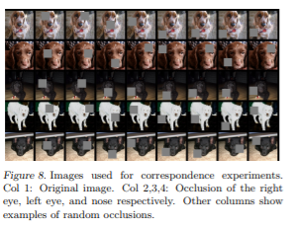
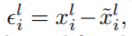
.
05
Convnet visualization-5
Correspondence analysis
Hamming distance for the degree of change
* i: index of image
* l/~l: original, occluded image’s feature map in layer1
* H: hamming distance
* sign(): function( +(1),-(-1),0(0) )
Result: Shading of important locations (eyes, nose, etc.) shows similar effects on features

Slide 17
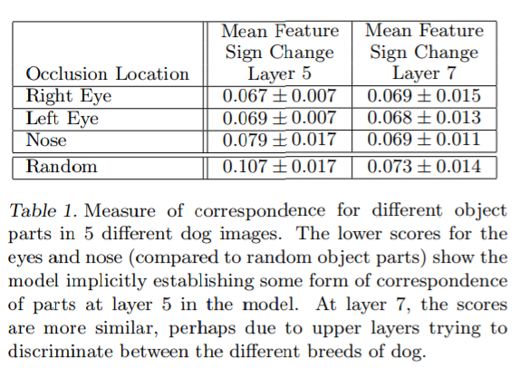
05
Convnet visualization-5
layer 5:
relatively low
( layer5 = feature object’s face)
layer 7:
Not big difference
(layer7 = distinguish species)

Slide 18
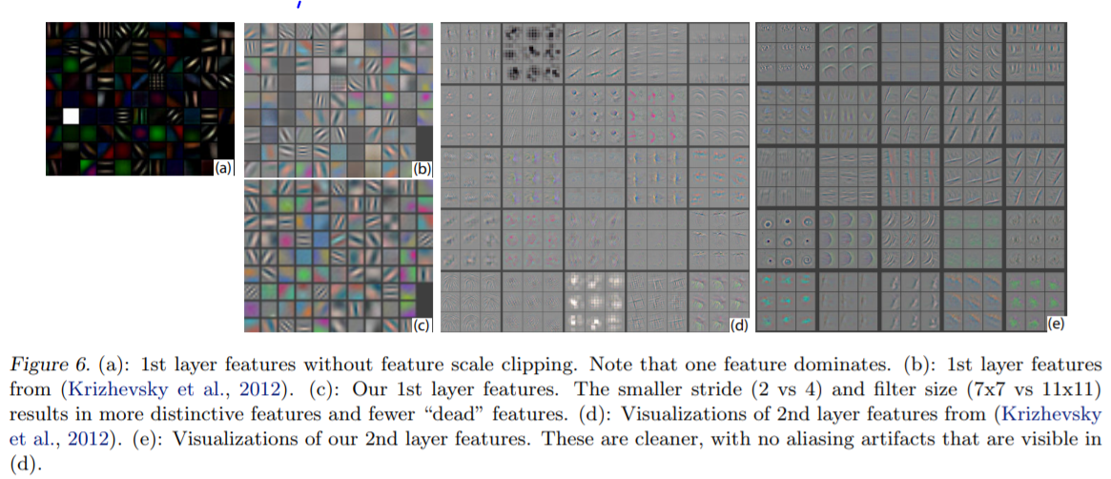
06
Architecture selection
(b): AlexNet layer1 feature -> less representive vector
(c): fixed layer1( stride, kernel) -> various features
(d): AlexNet layer2 feature (by visualization)
(e): ZFNet -> less aliasing artifact!
<Supplement of AlexNet>
Filters(layer1): blow up intermediate frequency information
S = 4 (layer1): cause aliasing problem in layer2
*Aliasing occurs when sampling frequency is too low(large filter&stride size)

Slide 19
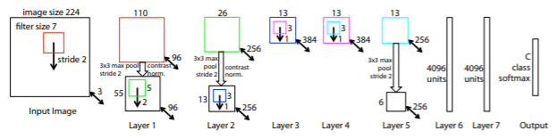
06
ZFNet
Run 1 GPU( 70epochs, 12 days)
For layer1 : filter size 11*11, s=4 -> 7*7, s=2 (output: 110*110)
For output: 3*3 overlapped max pool, s=2 ( 55*55 output)
Use dense connections in layer 3,4,5
All weights: set 10^-2, bias =0
Layer 6,7: dropout( same)
Parameters update: 128 size mini batch, using sgd

Slide 20
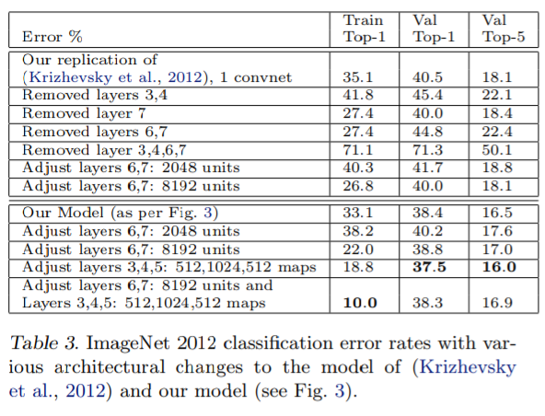
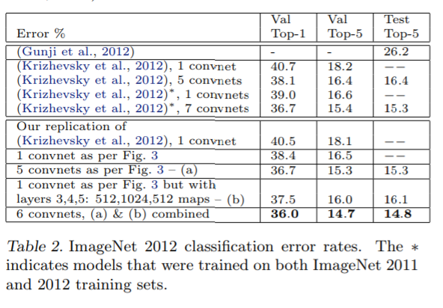
07
Experiments -1
Complement Alexnet
14.7% error rate
-Change, delete AlexNet’s layer/size
(study various structure)
-Depth of the model is important

Slide 21
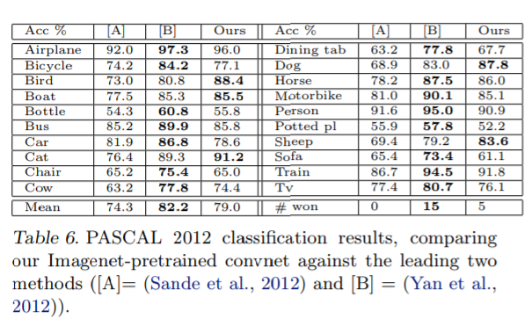
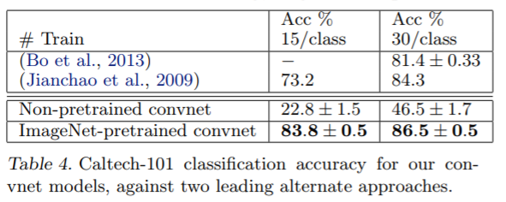
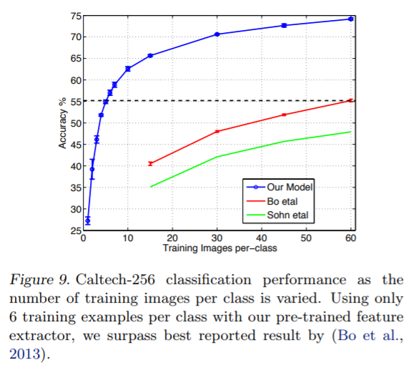
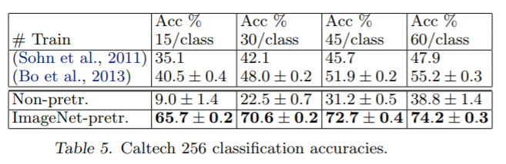
07
Experiments -2
Feature generation
*Dataset: Caltech-101 Caltech-256
Pascal voc 2012

Slide 22
08
Discussion
Suggest a way to visualize CNN
Better structure through visualization debugging(15.3% -> 14.7%)
Occlusion experiment: filters - Sensitive to local structure
Layers require enough depth
Fully Convolutional Networks for Semantic Segmentation(2015)
Rich feature hierarchies for accurate object detection and semantic segmentation(2014)
Fast R-CNN(2015)
*You Only Look Once: Unified, Real-Time Object Detection(2016)
SegNet: A Deep Convolutional Encoder-Decoder Architecture for Image Segmentation(2015)
DeepLab: Semantic Image Segmentation with Deep Convolutional Nets, Atrous Convolution,
and Fully Connected CRFs(2016)
RefineNet: Multi-Path Refinement Networks for High-Resolution Semantic Segmentation
(2016)
Generative Adversarial Nets(2014)
Pyramid Scene Parsing Network (2017)
Large Kernel Matters -- Improve Semantic Segmentation by Global Convolutional Network(2017)
Dense Decoder Shortcut Connections for Single-Pass Semantic Segmentation (2018)

Slide 23
감사합니다

